Slide 1

CREDIT SCORE
Customer credibility for credit to avoid loan defaulting.
www.reallygreatsite.com

Slide 2

Problem Statement
Equip financial institutions with the expertise and technological tools to manage their credit risk endeavours.
Presented By : Larana Corporate

Slide 3
Goals
Minimize loan default rates by incorporating loan eleigibility assessment to increase customer retention of low-risk borrowers thus support finanacial health of borderline customers.
Goals 1
Goals 2
Goals 3
Goals 4
Increase Customer Retention of Low-Risk Borrowers
Support Financial Health of Borderline Customers
Minimize Loan Default Rates
Improve Loan Eligibility Assessment
www.reallygreatsite.com
Presented By : Larana Corporate

Slide 4

METHODOLOGY
Exploratory Data Analysis (EDA)
Feature Selection: Using domain knowledge selected features that were most important to the objective of the project.
Model Development: Logistic Regression, Random Forest Classifier, XG Boost from Scikit Learn’s library.
Model performance: Scikit Learn’s evaluation metrics, ROC-AUC curve.
www.reallygreatsite.com

Slide 5
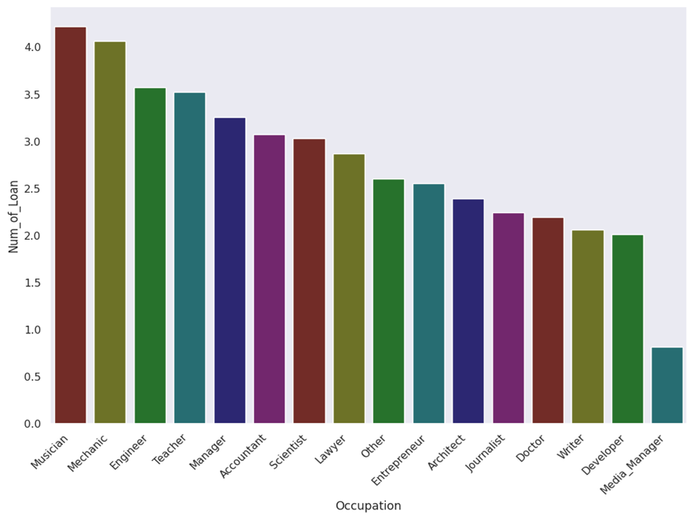
DATA OVERVIEW
Occupation Vs Number of Loans
The graph show the customers grouped according to occupation and the average number of loans for each occupation.

Slide 6
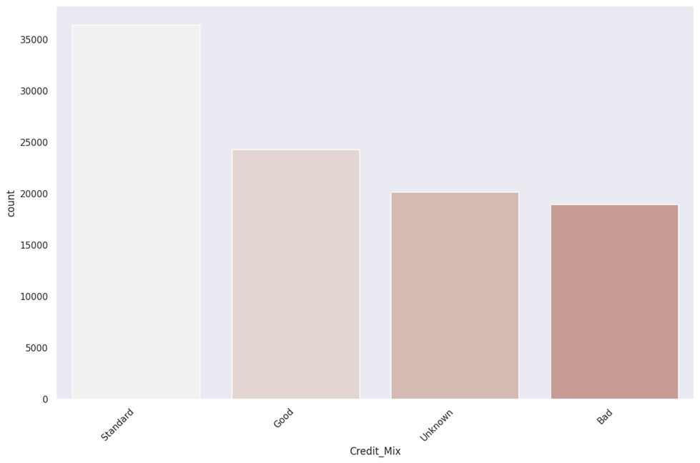
DATA OVERVIEW
Credit Mix counts
Despite having a large number of customers who cannot be accounted for not being in either category most of them have a fairly stable credit behaviour.
View More
www.reallygreatsite.com
Presented By : Larana Corporate

Slide 7
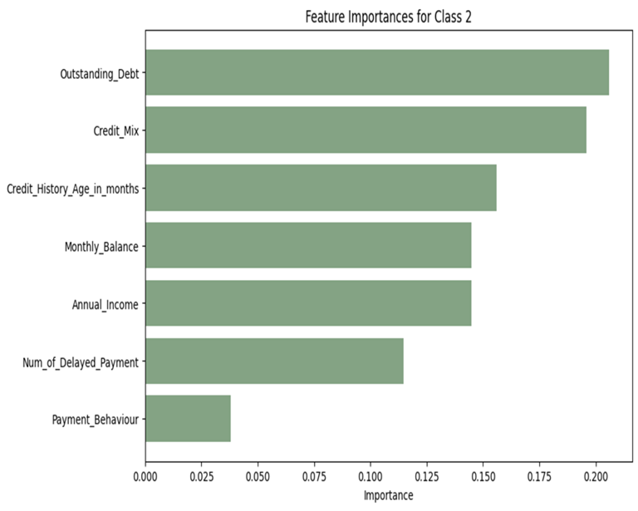
KEY INSIGHTS
Particular features contributed immensely to why a customer is most likely to be categorised as Standard, Poor or Good:
Outstanding debt
Credit_Mix
Credit_History
Monthly_balance
Annual_Income
www.reallygreatsite.com
Presented By : Larana Corporate

Slide 8
RECOMMENDATIONS
Introduce automated reminders for due dates and suggest early payment incentives
Offer financial planning resources to help customers manage their monthly cash flow effectively.
DEBT MANAGEMENT
CREDIT MIX
MONTHLY BALANCE
CREDIT HISTORY
Offer financial planning resources to help customers manage their monthly cash flow effectively
Implement loyalty programs that reward long-term, responsible credit behavior
www.reallygreatsite.com
Presented By : Larana Corporate

Slide 9
NEXT STEPS
Regular Credit Score Monitoring
Financial Literacy Programs
Offer free credit score tracking and reports to help customers stay informed and make proactive adjustments
Launch educational initiatives to teach customers how these factors influence their credit scores
Proactive Customer Support
Monitor finances
Provide personalized guidance based on individual financial profiles.
A magazine is a periodical publication, which can either be printed or published electronically.
www.reallygreatsite.com
Presented By : Larana Corporate

Slide 10
THANK YOU
Presented By : Larana Corporate

